Slide 1

Digital Image Processing
Dr. Mubashir Ahmad (Ph.D.)

Slide 2
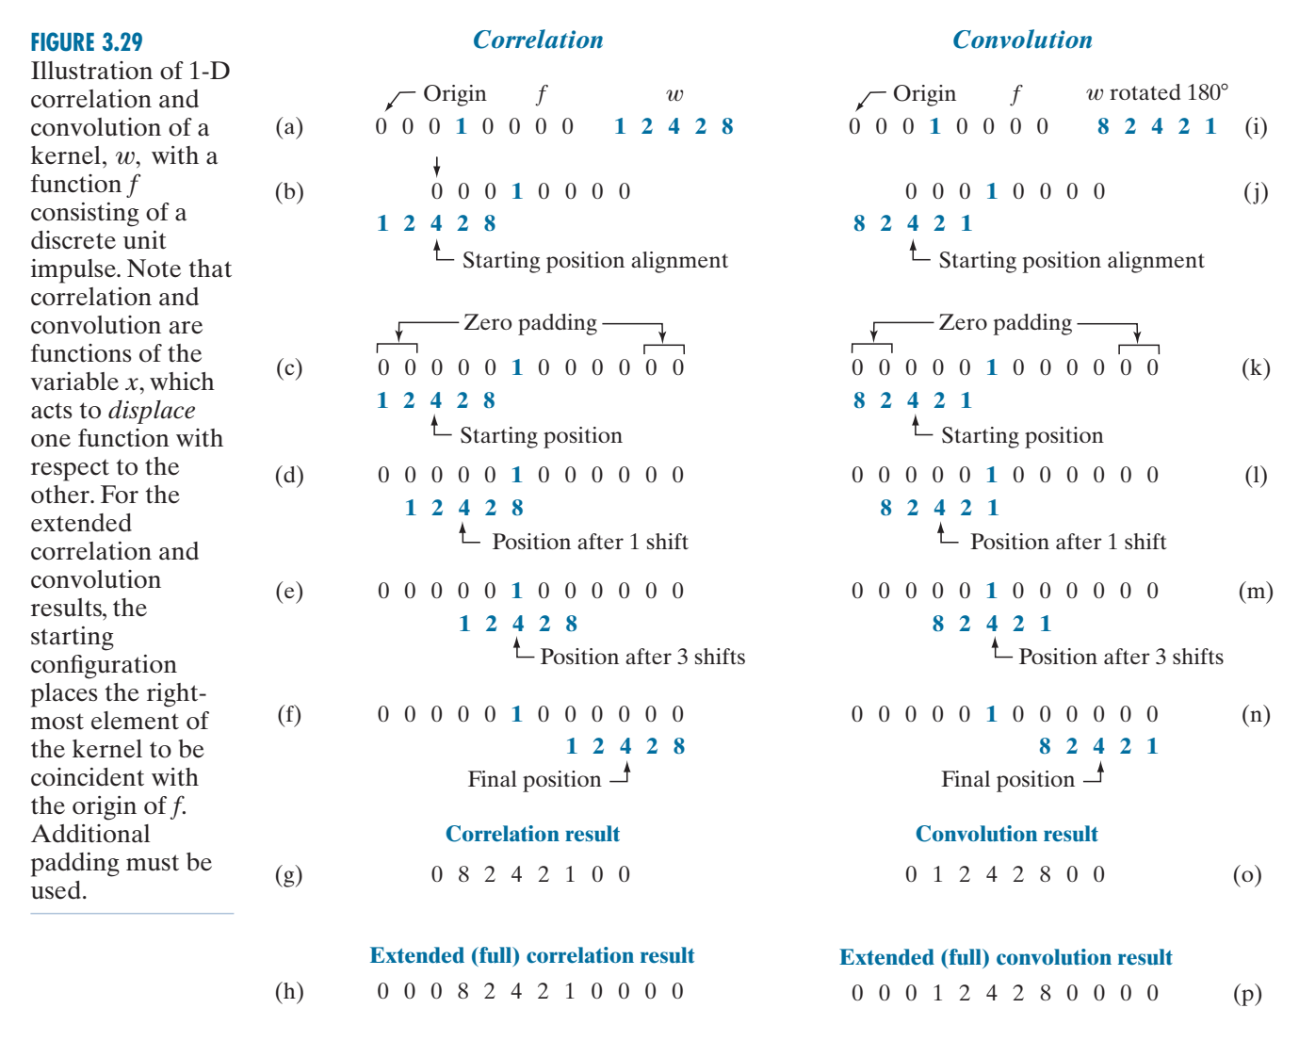
SPATIAL CORRELATION AND CONVOLUTION

Slide 3
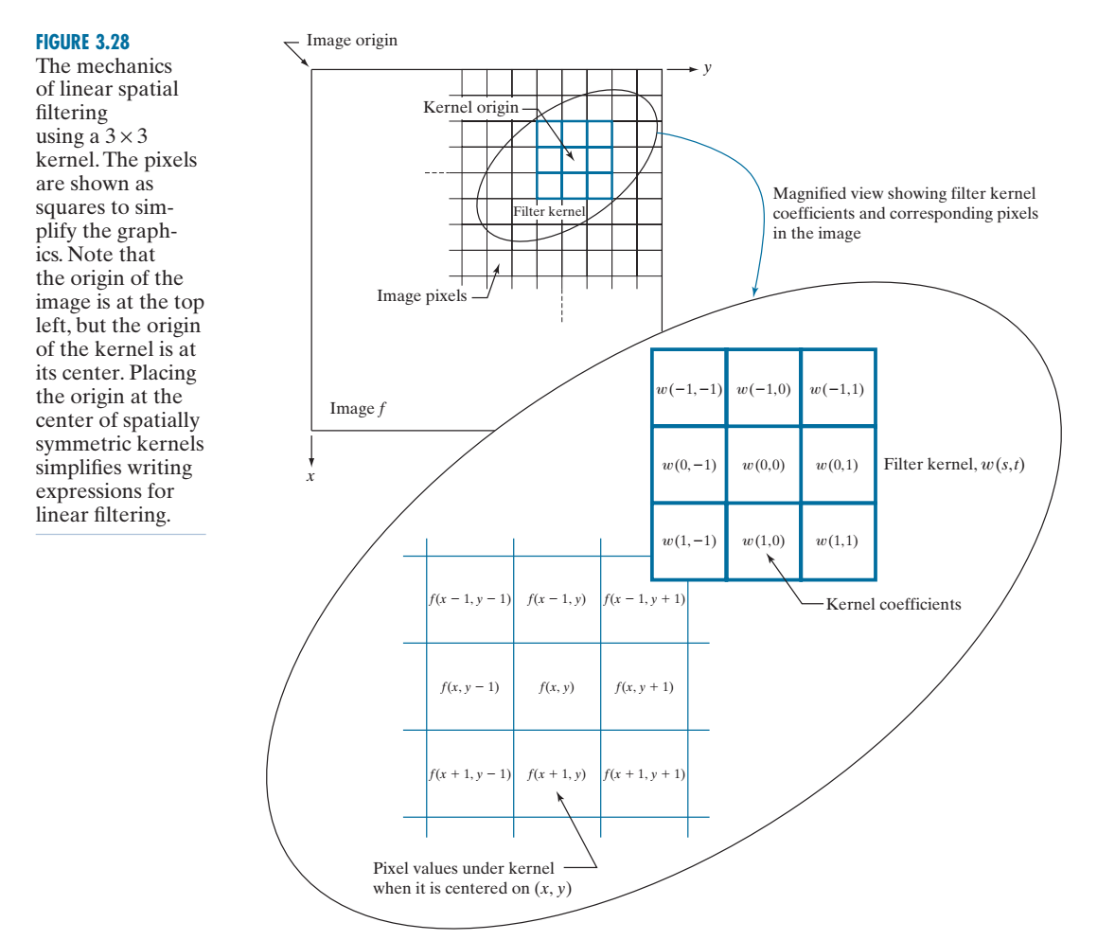

Slide 4
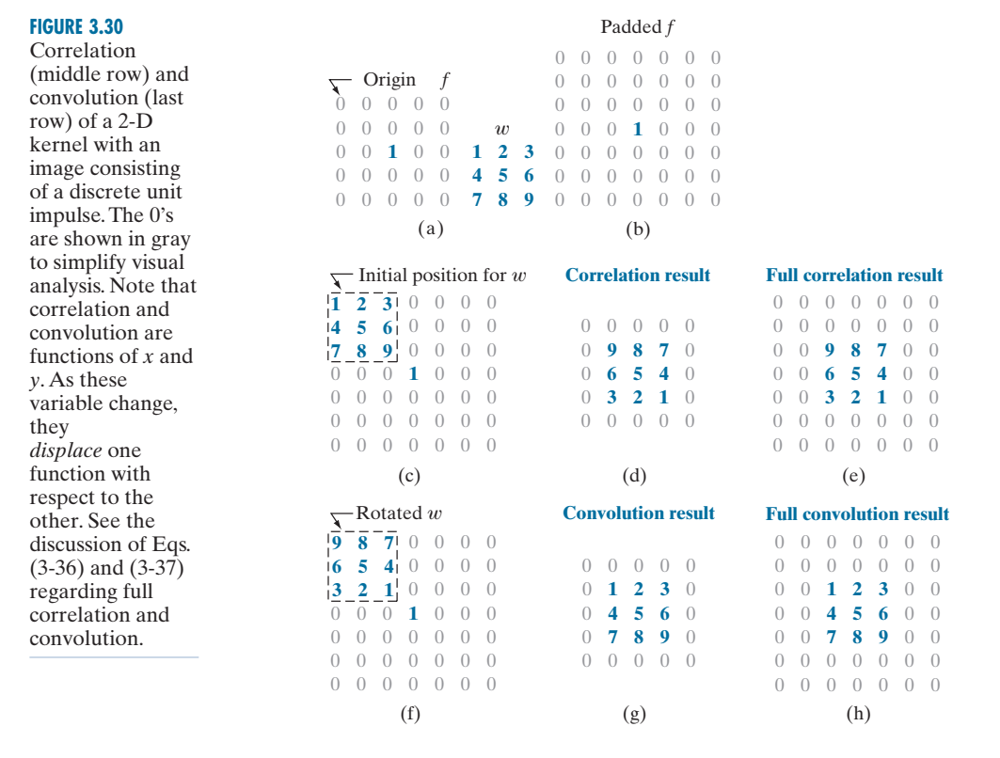

Slide 5
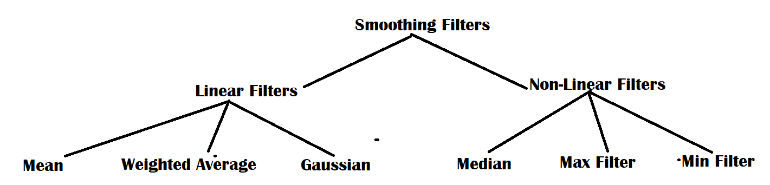
Types of Smoothing Filters

Slide 6
Spatial filters classification filters
Spatial filters can be classified by effect:
Smoothing Filters: Aim to remove some small isolated detailed pixels by some form of averaging of the pixels in the masked neighborhood. These are also called lowpass filters.
Examples include Averaging, Weighted Average, Gaussian, order statistics filters etc.
Sharpening Filters: aiming at highlighting some features such as edges or boundaries of image objects.
Examples include the Laplacian , Gradient filters etc.
Spatial filters are also classified in terms of mask size (e.g. 3x3, 5x5, or 7x7).
The maximum allowable mask size for spatial filters is 31x31.

Slide 7
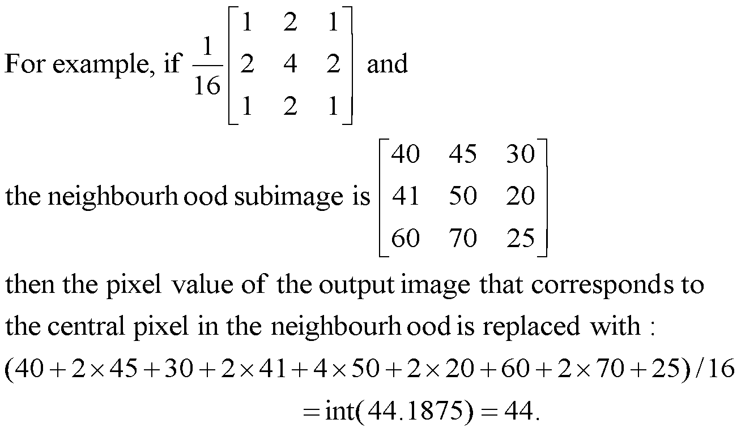
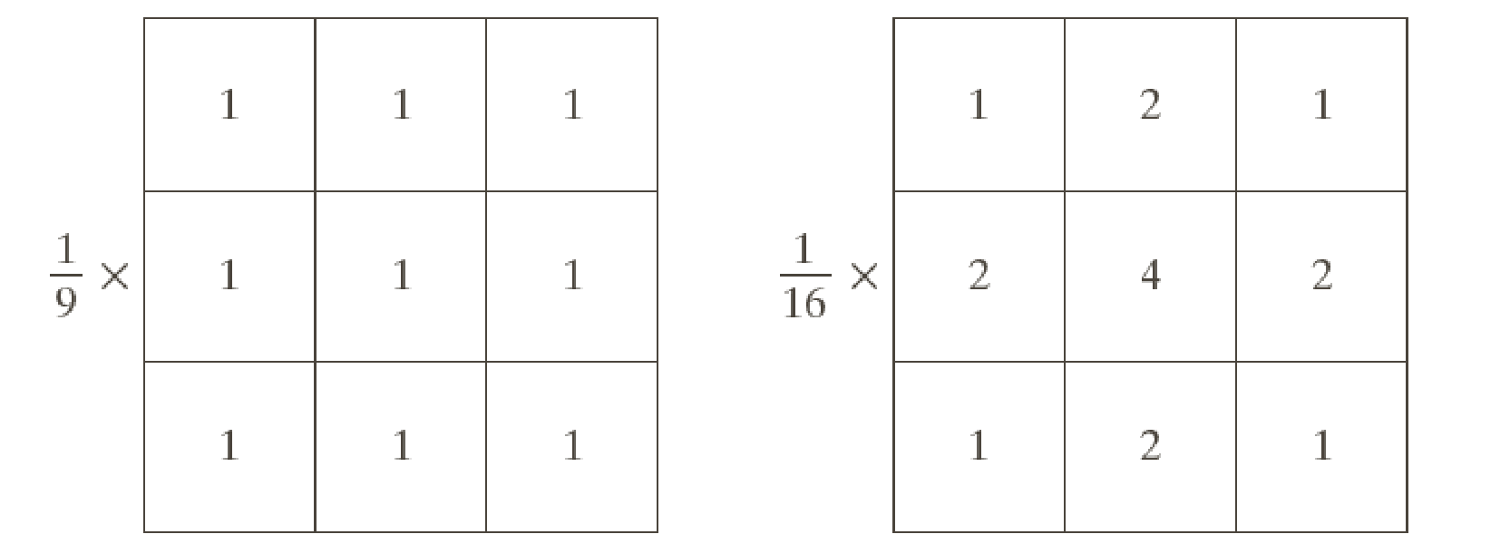
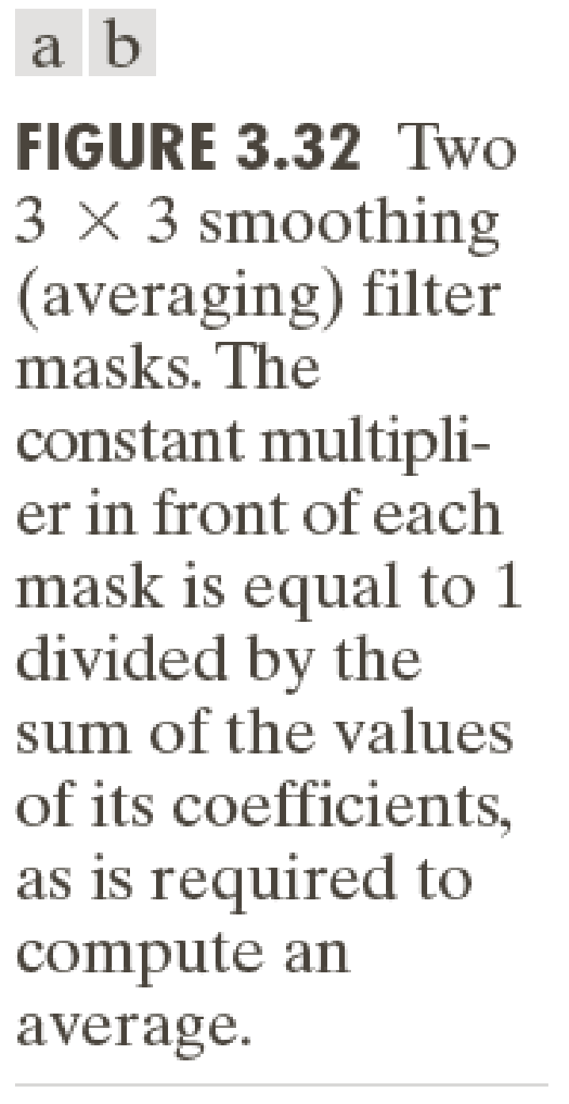
A weighted average filter – Example and averaging filter mask

Slide 8
Smoothing filters
Smoothing Filters are particularly useful for blurring and noise reduction.
Smoothing filters work by reducing sharp transition in grey levels.
Noise reduction is accomplished by blurring with linear or non-linear filters (e.g. the order statistics filters).
Beside reducing noise, smoothing filters often remove some significant features and reduce image quality.
Increased filter size result in increased level of blurring which result in the reduction of noise and it also reduced image quality.
Subtracting a blurred version of an image from the original may be used as a sharpening procedure.

Slide 9
Gaussian smoothing filter
A Gaussian smoothing filter is an image-filtering technique commonly used in image processing to reduce noise and smooth out an image. The filter works by convolving the image with a Gaussian function, a bell-shaped curve representing a probability distribution.
To apply a Gaussian smoothing filter to an image, the image is convolved with the Gaussian function. The size of the Gaussian filter kernel is determined by the standard deviation of the Gaussian function. The kernel is centered on each pixel in the image, and the intensity value of each pixel is replaced by a weighted average of the intensities of the surrounding pixels, with the weights determined by the values of the Gaussian function at each pixel location.

Slide 10
Gaussian smoothing filter
The Gaussian smoothing operator is a 2-D convolution operator that is used to `blur' images and remove detail and noise. In this sense it is similar to the mean filter, but it uses a different kernel that represents the shape of a Gaussian (`bell-shaped') hump.

Slide 11
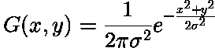
Gaussian smoothing filter
a case of weighted averaging – The coefficients are a 2D Gaussian. – Gives more weight at the central pixels and less weights to the neighbors. – The farther away the neighbors, the smaller the weight.

Slide 12
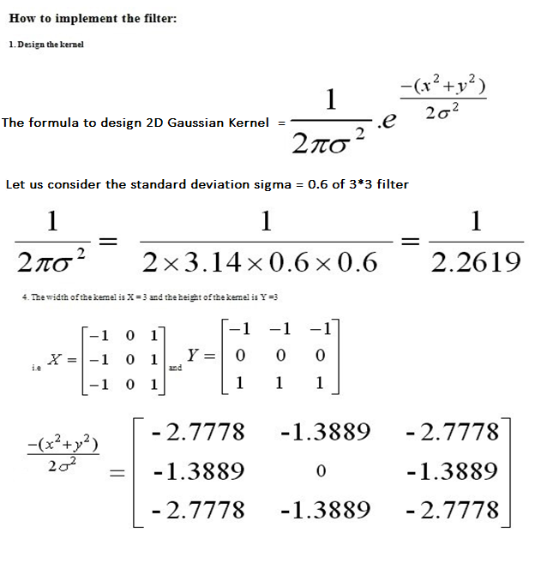
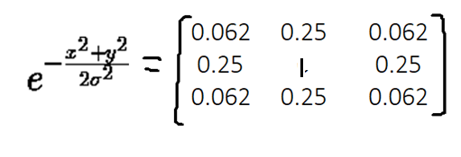
Filter designing

Slide 13
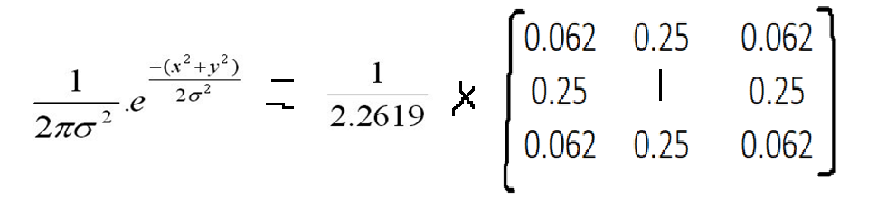
Filter designing

Slide 14
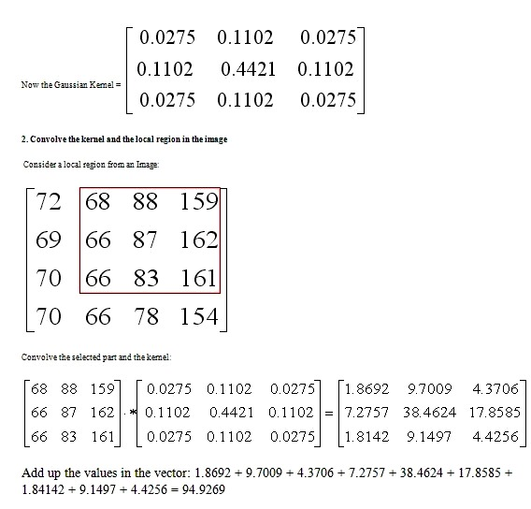
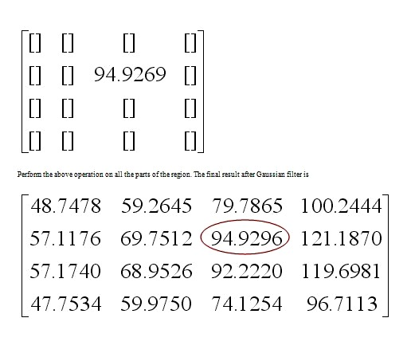

Slide 15
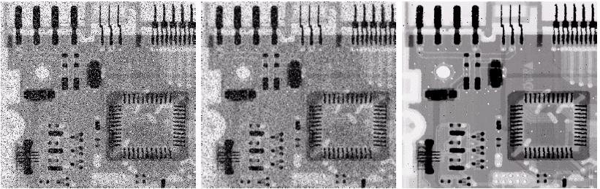
Order Statistical filters
These refer to non-linear filters whose response is based on ordering the pixels contained in the neighborhood. Examples include Max, Min, Median filters.
The median which replaces the value at the centre by the median pixel value in the neighbourhood, (i.e. the middle element when they are sorted.
Median filters are particularly useful in removing impulse noise, also known as salt-and-pepper.
Noisy image
Averaging 3x3 filter
Median 3x3 filter

Slide 16
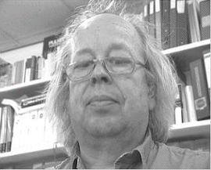
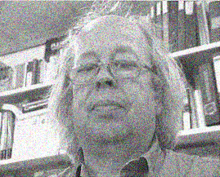
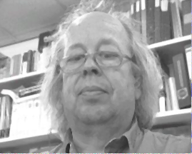
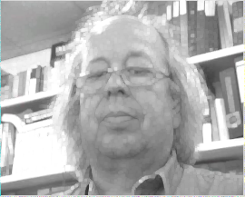
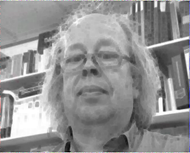
Example – Effect of different order statistics filters
Adding Noise
3x3 median
3x3 max
3x3 min

Slide 17
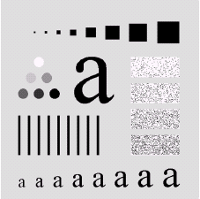
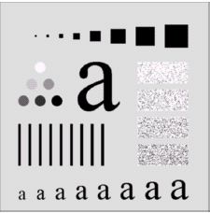
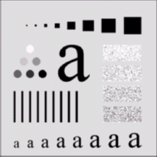
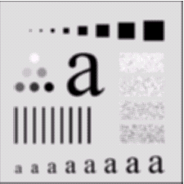
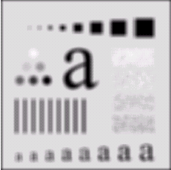
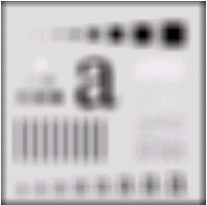
Effect of Averaging Linear Filters
original
3x3 filter
5x5 filter
9x9 filter
35x35 filter
15x15 filter
The extent of burring increases the larger the filter is.

Slide 18
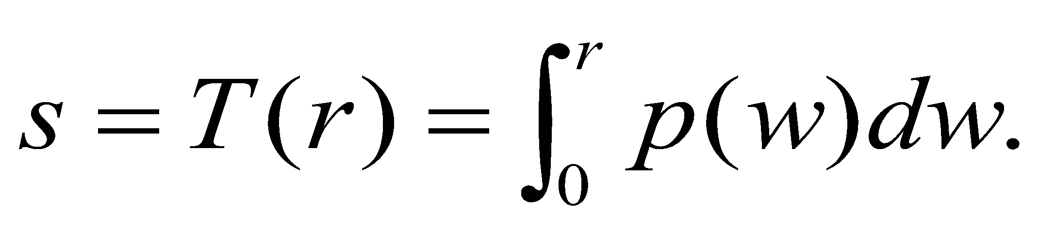
Sharpening Spatial Filters
Sharpening aims to highlight fine details (e.g. edges) in an image, or enhance detail that has been blurred through errors or imperfect capturing devices.
Image blurring can be achieved using averaging filters, and hence sharpening can be achieved by operators that invert averaging operators.
In mathematics averaging is equivalent to the concept of integration along the gray level range:
Integration inverts differentiation and as before, we need a digitized version of derivatives.

Slide 19
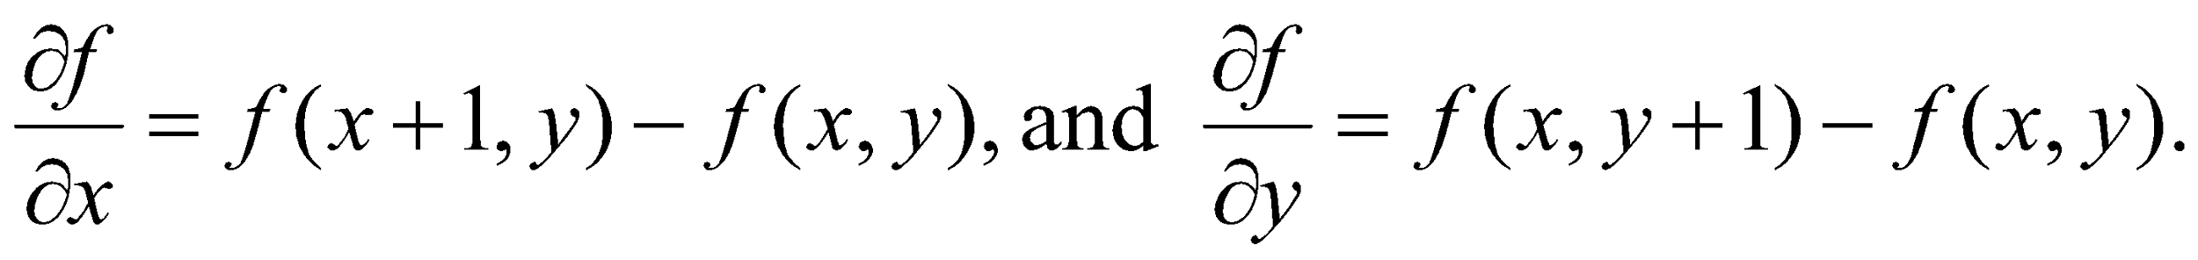
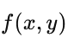
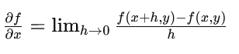
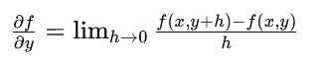


Derivatives of Digital functions of 2 variables
As we deal with images, which are represented by digital function of two variables, then we use the notion of partial derivatives rather than ordinary derivatives.
The first order partial derivatives of the digital image f(x,y) in the x and in the y directions at (x,y) pixel are:
The first derivative is 0 along flat segments (i.e. constant gray values) in the specified direction.
It is non-zero at the outset and end of sudden image discontinuities (edges or noise) or along segments of continuing changes (i.e. ramps).

Slide 20
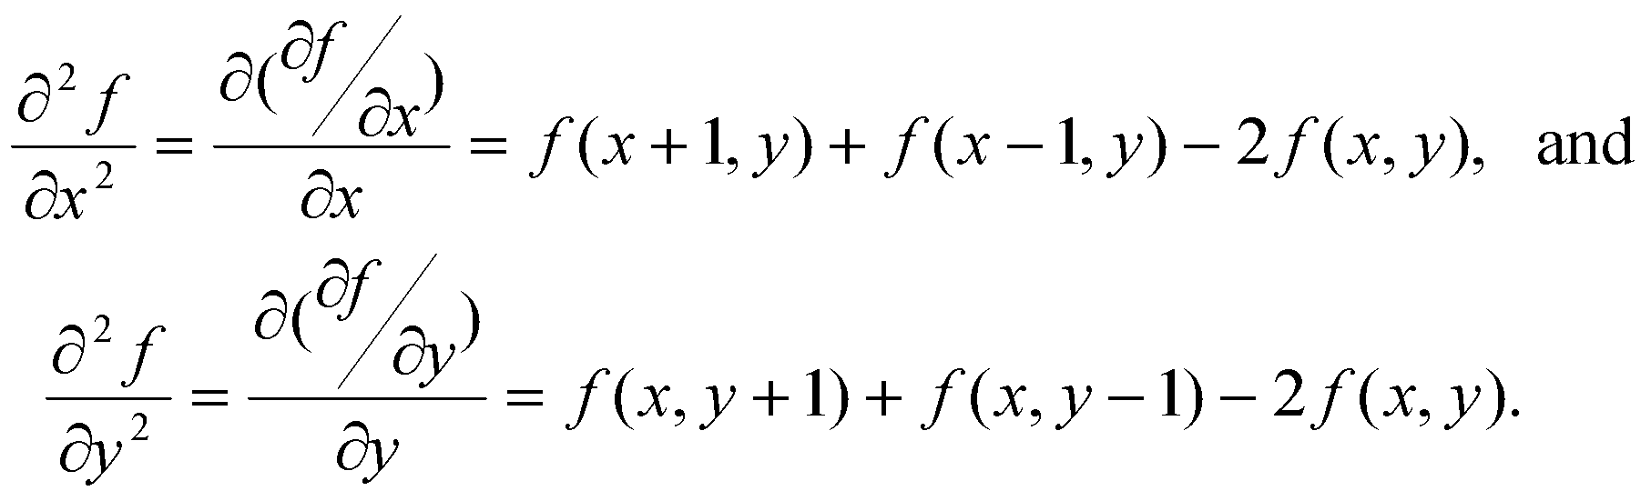
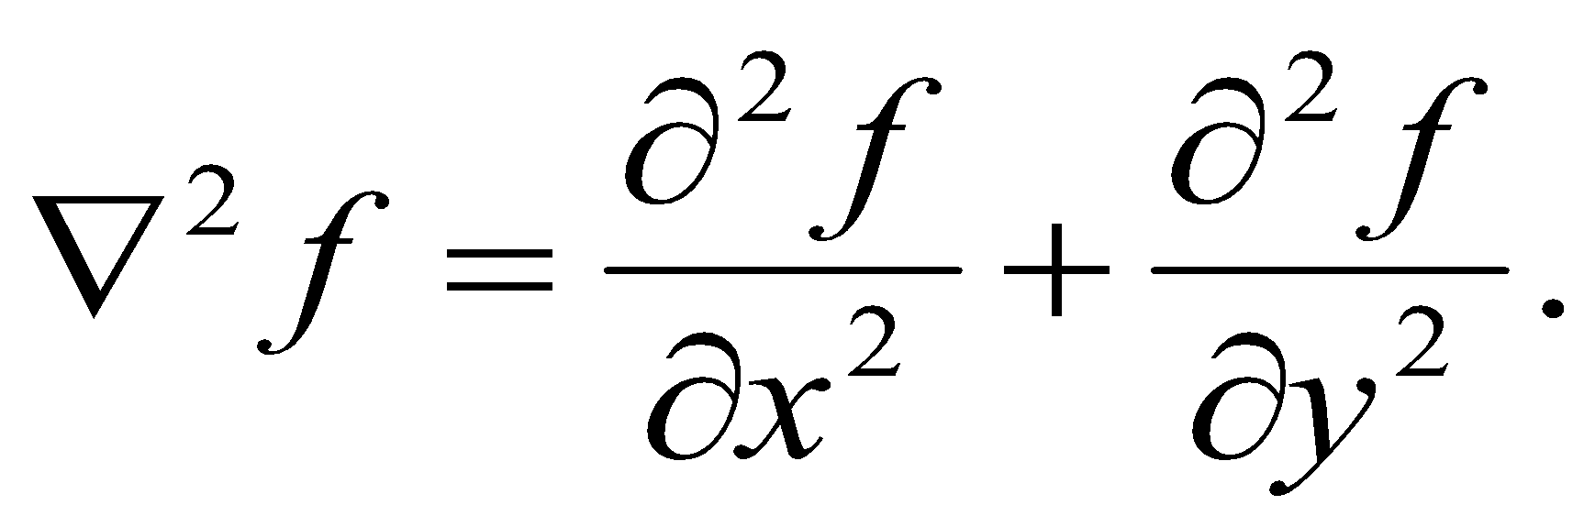
2nd order Derivatives & the Laplacian operator
The first derivative of a digital function f(x,y) is another digital image and thus we can define 2nd derivatives:
Other second order partial derivatives can be defined similarly, but we will not use here.
The Laplacian operator of an image f(x,y) is:

Slide 21
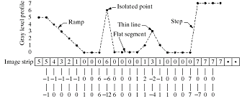
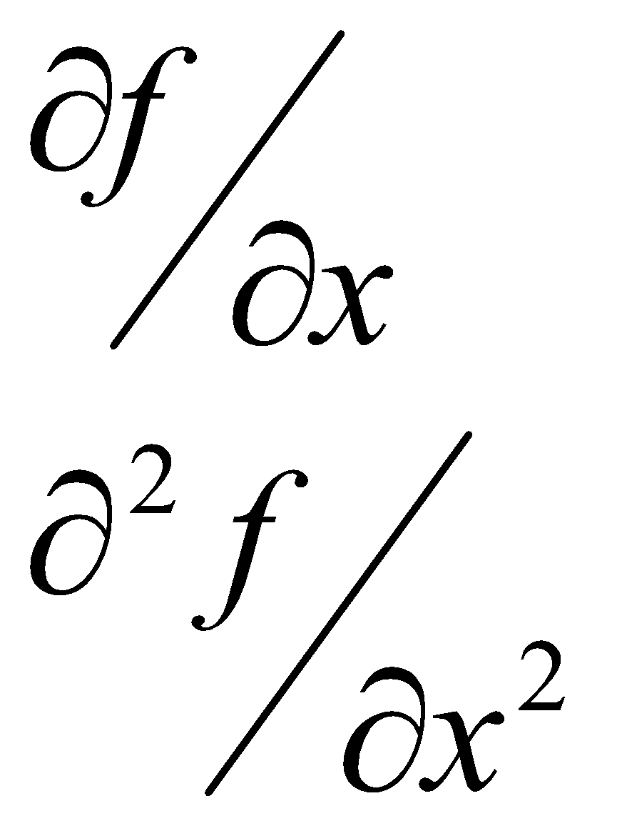
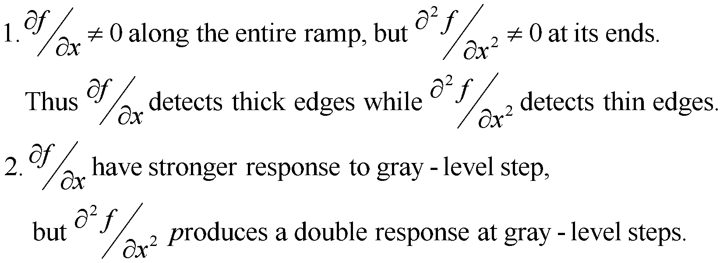
Digital derivatives –Example

Slide 22
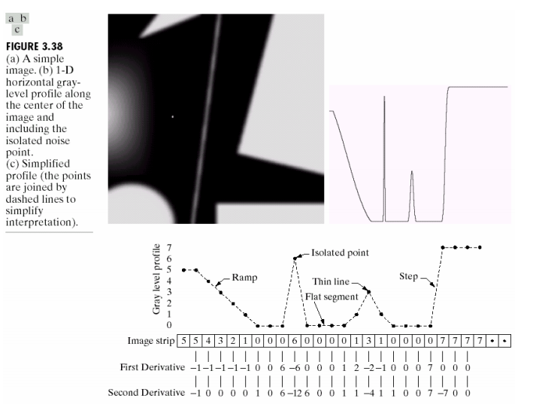



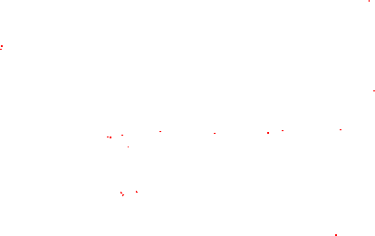

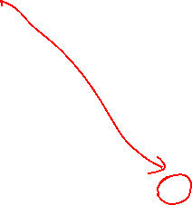











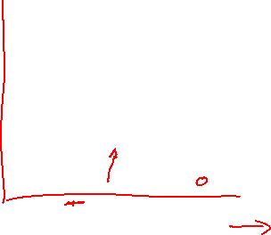









Slide 23
Observations
1st order derivatives produce thicker edges
2nd order derivatives have stronger response to finer details
1st order derivatives have stronger response to gray level step
2nd order derivatives produce double response to step changes
Both 1st and 2nd order derivatives produce negative pixel values
Shift output image for display
Some applications use only the absolute value
overall 2nd order is better for most of the cases

Slide 24
Laplacian operator
Usually the sharpening filters make use of the second order operators.
A second order operator is more sensitive to intensity variations than a first order operator.
Besides, partial derivatives has to be considered for images
The derivative in a point depends on the direction along which it is computed.
Operators that are invariant to rotation are called isotropic.
Rotate and differentiate (or filtering) has the same effects of differentiate and rotate.
The Laplacian is the simpler isotropic derivative operator (wrt. the principal directions):

Slide 25
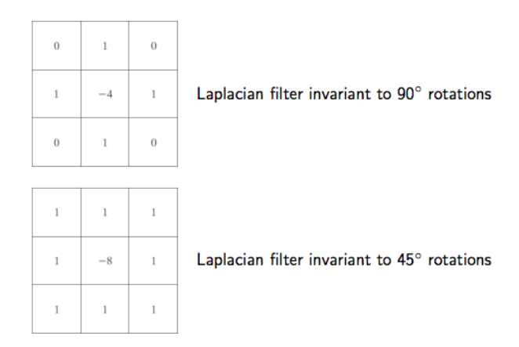
Laplacian filter

Slide 26
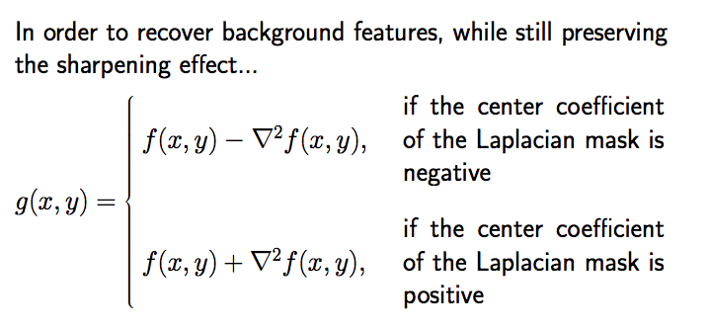


Laplacian filter

Slide 27
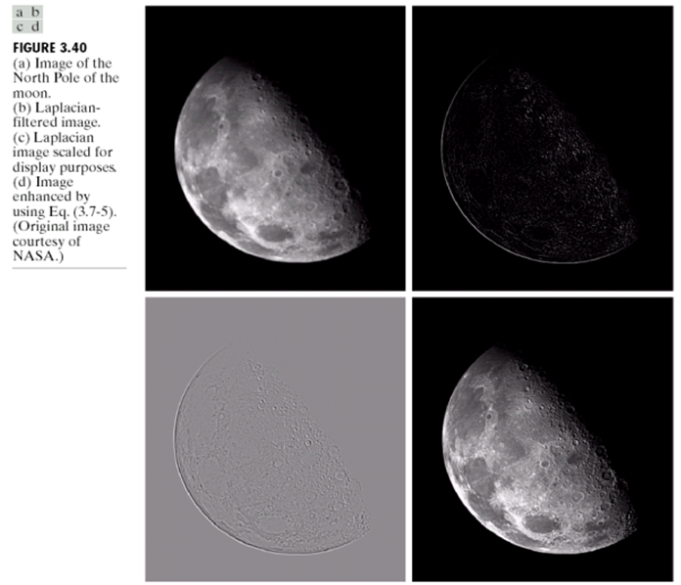

Slide 28
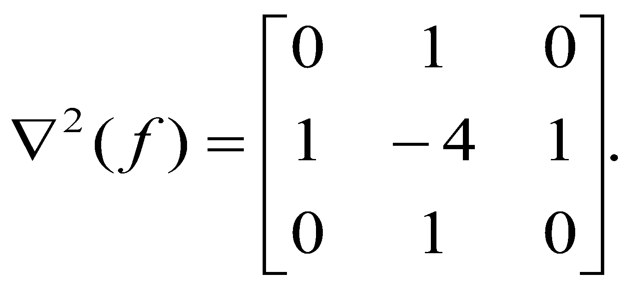
The Laplacian Filter
The Laplacian operator, applied to an Image can be implemented by the 3x3 filter:
Image enhancement is the result of applying the difference operator:

Slide 29
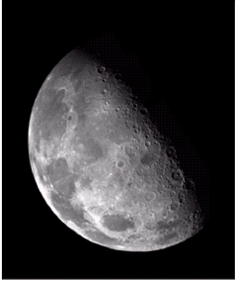
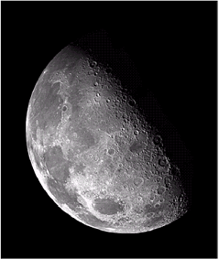
Laplacian filter –Example
Original Image
Image after Laplacian filer
Note the enhanced details after applying the Laplacian filter.

Slide 30
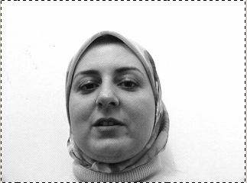
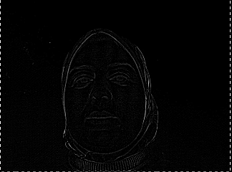
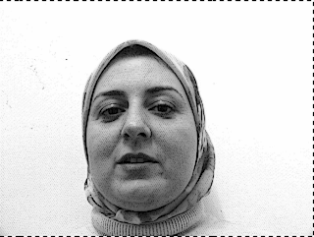
Example
Laplacian Operator
Laplacian Enhanced
Image = f - ∇²f.

Slide 31
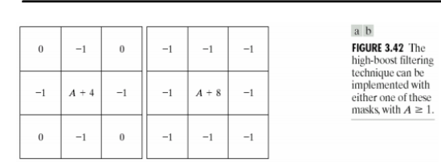


Mask of High Boost

Slide 32
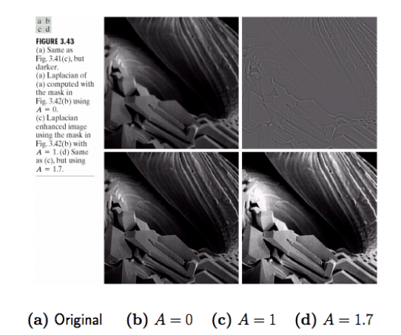


Slide 33
Combining various enhancement filters
The effect of the various spatial enhancement schemes doesn’t always match the expectation, and depends on input image properties.
e.g. histogram equalization introduces some noise.
The application of any operator at any pixel does not depend on the position of the pixel, while the desired effect is often required in certain regions.
e.g. an averaging filters blurs smooth areas as well as significant feature regions.
Enhancing an image is often a trial & error process.
In practice one may have to combine few such operations in an iterative manner .
In what follows we try few combined operations.

Slide 34





Combining Laplacian and HE
LAPChris
HEChris
LAPHEChris
HELAPChris

Slide 35




Combined Laplacian & HE
(b)
(a)
(c)
(d)
(a) Original, (b) After HE, (c) After Laplacian, (d) HE after Laplacian

Slide 36
Gradient in edge detection
An image gradient is a directional change in the intensity or color in an image. The gradient of the image is one of the fundamental building blocks in image processing.
The Sobel filter is used for edge detection. It works by calculating the gradient of image intensity at each pixel within the image. It finds the direction of the largest increase from light to dark and the rate of change in that direction.

Slide 37

Sobel convolution kernel

Slide 38










Sobel convolution kernel

Slide 39
Prewitt gradient edge detector
It simply works like as first order derivate and calculates the difference of pixel intensities in a edge region. As the center column is of zero so it does not include the original values of an image but rather it calculates the difference of right and left pixel values around that edge.

Slide 40













































Masks for the Prewitt gradient edge detector

